Slide 1
Oil Price – A Comprehensive Outlook
Blanca carretero
Truth Price
Jack Lloyd
Harshad Patil
Georgia Tech - Data Analytics Bootcamp – July 16 2022

Slide 2
Oil Price Study:
Its Drivers:
Global Supply Demand
Geopolitical Issues
Increased US Oil & Gas Production
Its Effects on US:
Paying way higher gas Prices
Inflation
Unemployment rate
Presidential Approval Ratings
Source: https://www.worldometers.info/oil/

Slide 3
Data Analysis and Visualization programs:
d3.js and Leaflet.js to plot the US Shale oil Basins Geojson file
Python pandas – scrape website and Postgress Database
Matplotlib – finalize visualization
Python- clean data before using in d3.js
Lots of csv’s in d3.js-plotly.js
Plotly.js for data visualization
Html/css

Slide 4
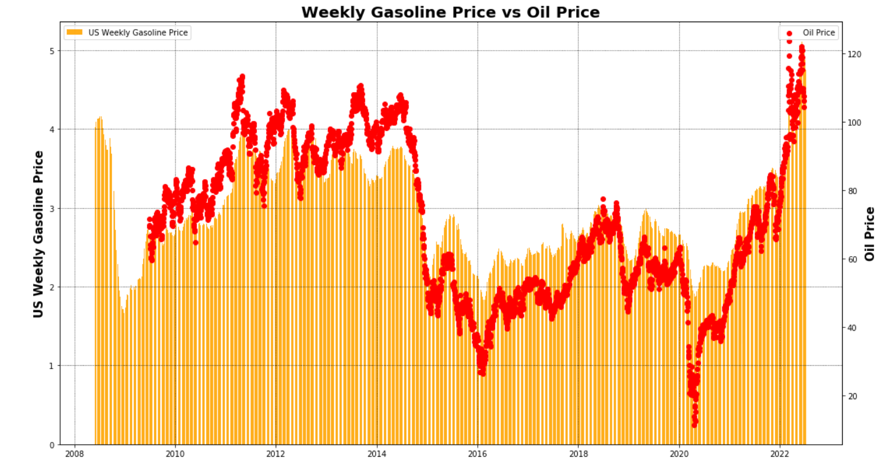
Gas Price at the station – Kidding me?

Slide 5
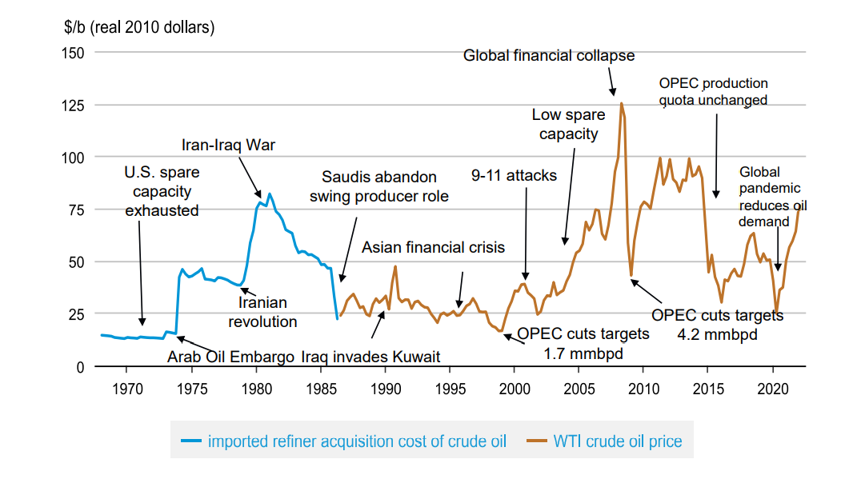
History of Oil Price & World Events
Oil price during US elections
Oil Price & economic meltdown 2008
Oil Price and 2016 (Increased US Oil Production)
Oil Price and Global Pandemic

Slide 6
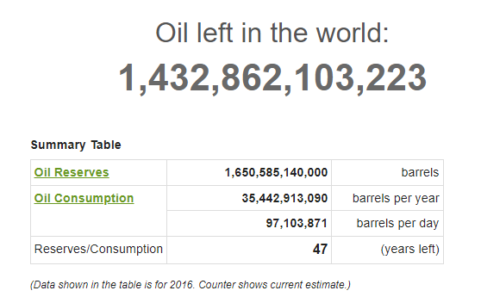
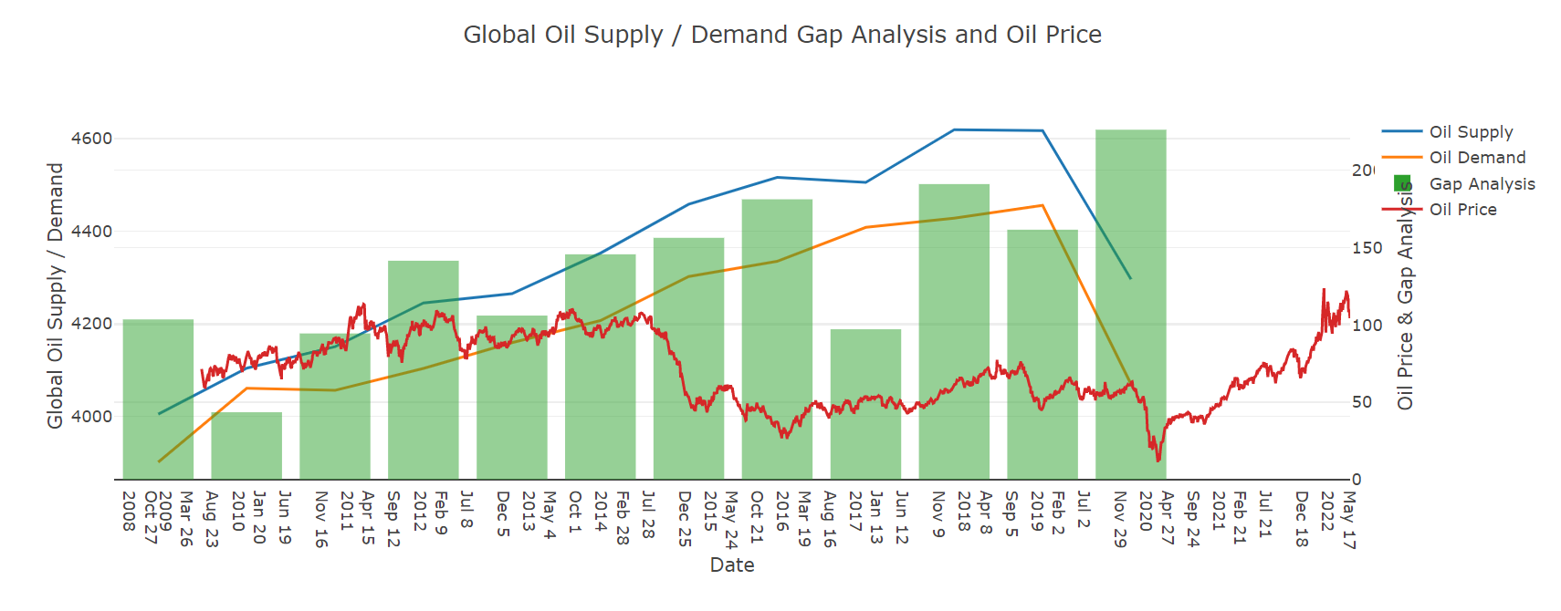
Drivers: Global Oil Supply/Demand

Slide 7
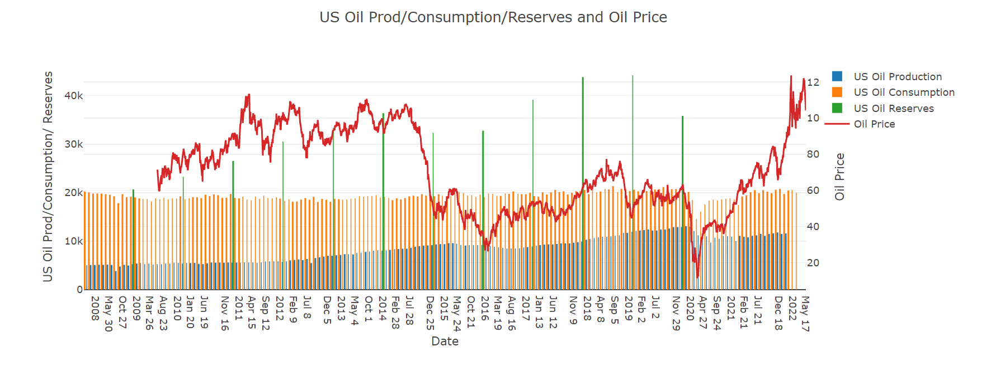
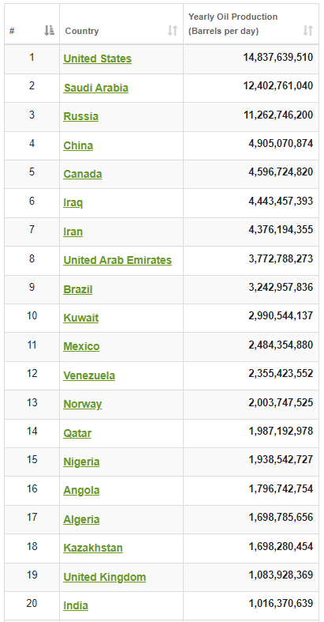
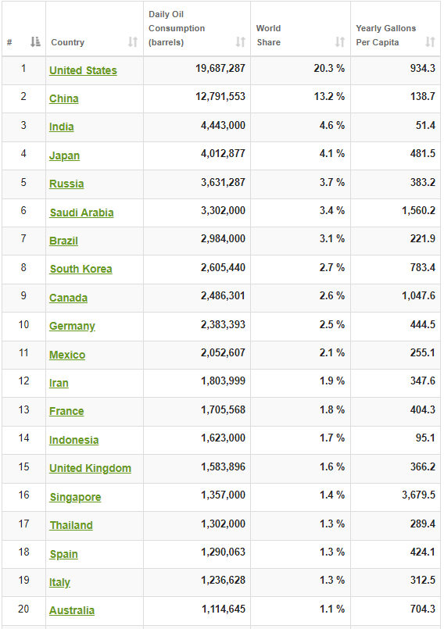
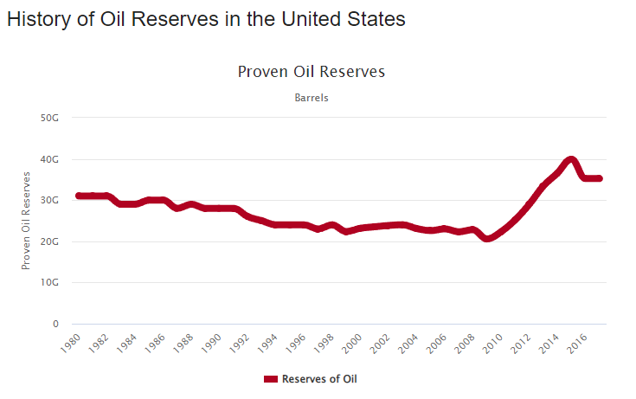
Drivers: US Oil Production - Biggest Oil Consumers & Producers Globally
Top Oil Producers
Top Oil Consumers
Source: https://www.worldometers.info/oil/

Slide 8
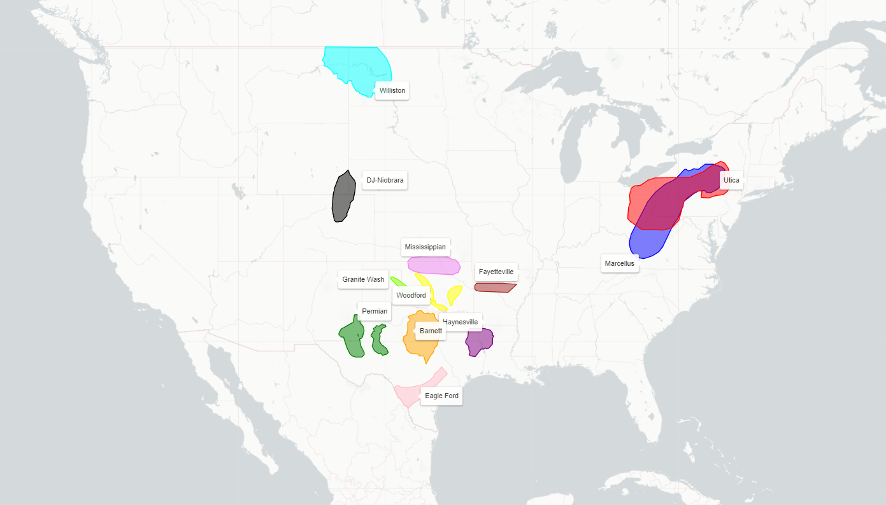
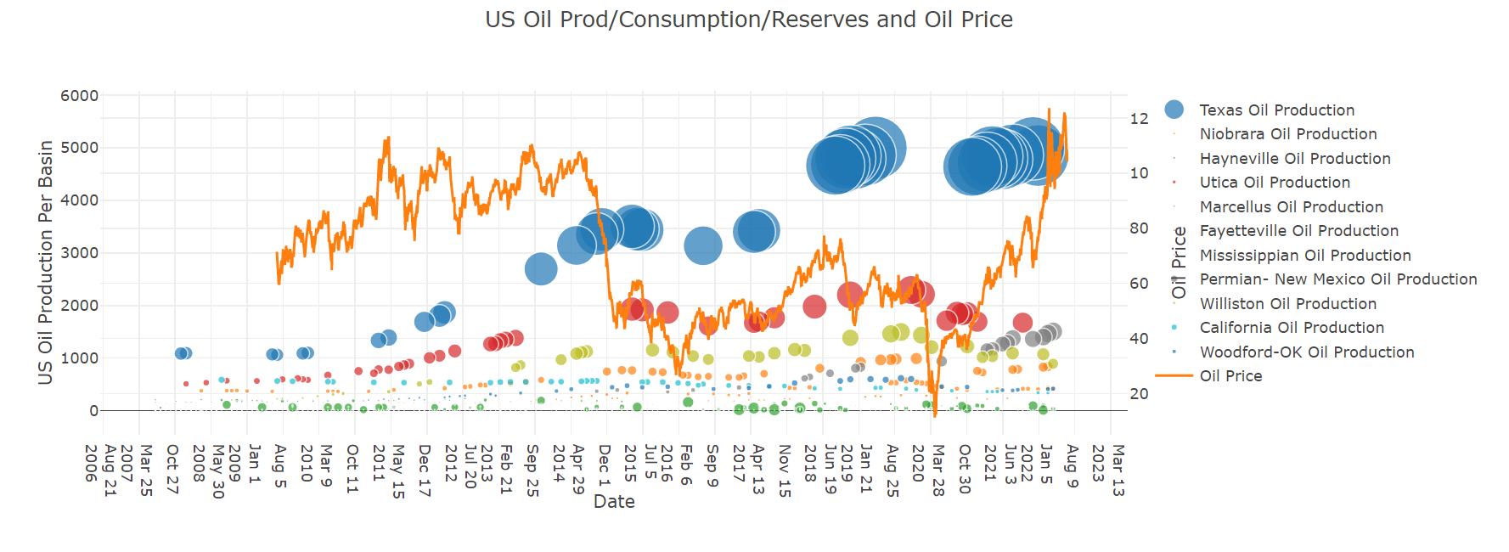
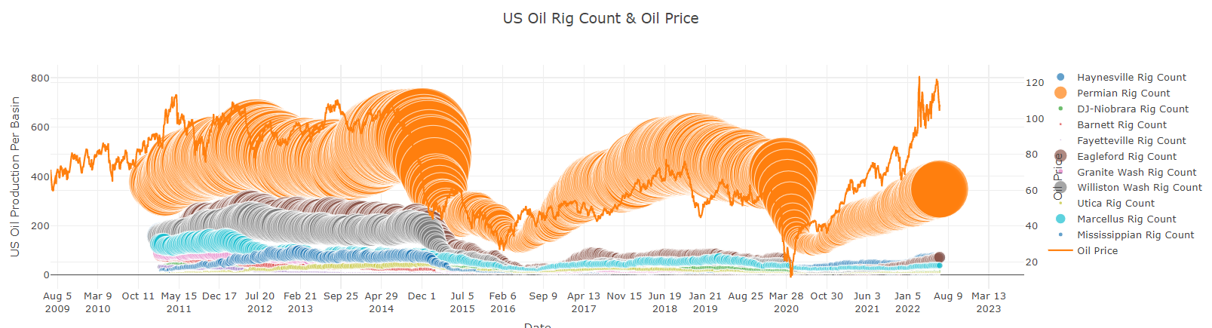
Oil Price Drivers: Major US Shale Fields
Alaska
Offshore
Biggest Rig Count in the World

Slide 9
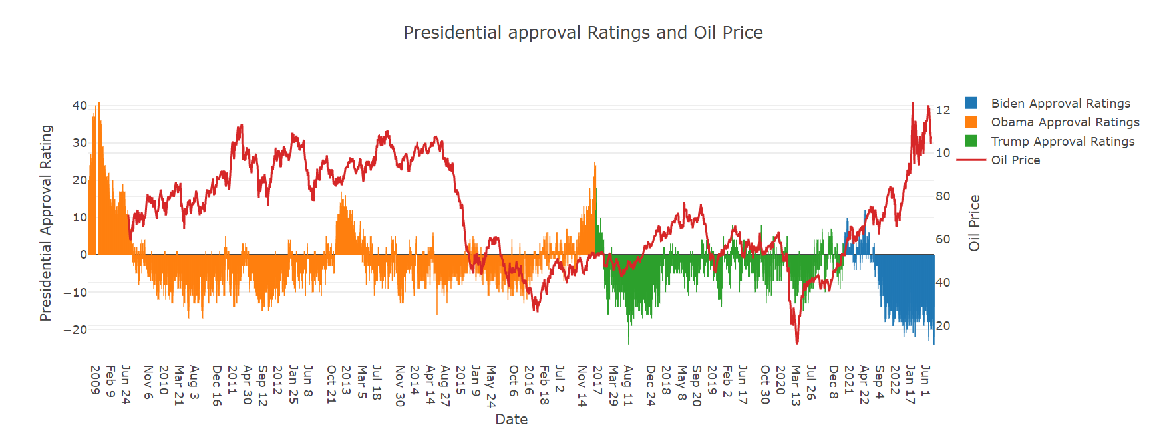
Oil Price Effects: Presidential Approval Rating and Oil Price
Source: https://www.worldometers.info/oil/

Slide 10
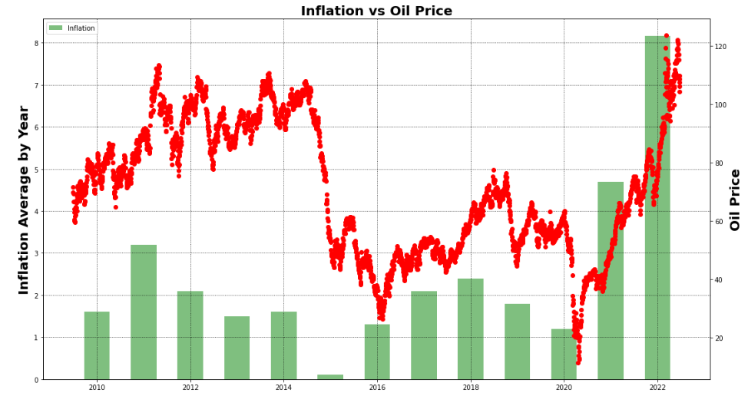
Oil Price and Inflation

Slide 11
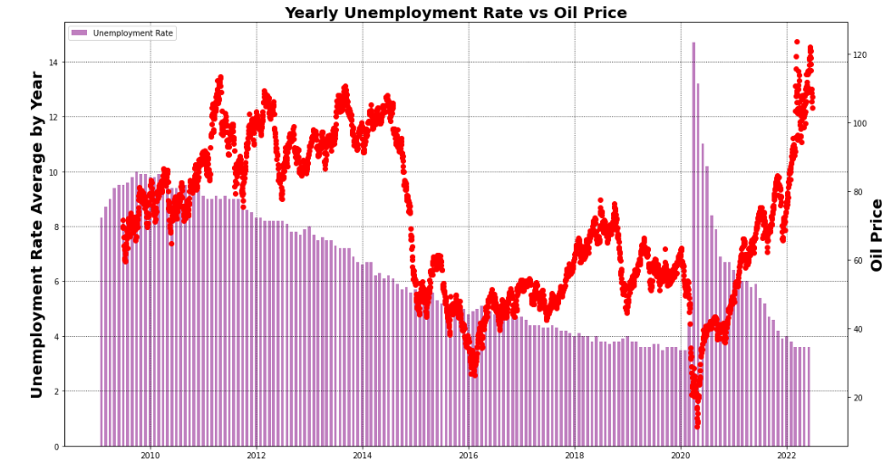
Unemployment (U3) vs Oil Price

Slide 12
Continuing Work:
Add a choropleth for oil production and rig count data on leaflet.js
Adding a drop-downmenu / slider for populating data

Slide 13
Thank you ! Questions?

